Slide 1
Box Shadow

Slide 2

CSS Shadow Effects
With CSS you can add shadow to text and to elements.
In this chapter you will learn about the following properties:
Text-shadow
Box-shadow
Short Hand---Box Shadow

Slide 3
CSS3 2D Transforms

Slide 4
CSS3 Transforms
With CSS3 transform, we can move, scale, turn, spin, and stretch elements.
A transformation is an effect that lets an element change shape, size and position.
You can transform your elements using 2D or 3D transformation.

Slide 5
CSS3 2D Transforms
The 2d transform methods:
translate()
rotate()
scale()
skew()

Slide 6
The translate() Method
With the translate() method, the element moves from its current position, depending on the parameters given for the left (X-axis) and the top (Y-axis) position:
div { -ms-transform: translate(50px,100px); /* IE 9 */ -webkit-transform: translate(50px,100px); /* Chrome, Safari*/ transform: translate(50px,100px); /*Standard syntax*/; }

Slide 7
The rotate() Method
div { -webkit-transform: rotate(30deg); /* Chrome, Safari, Opera */ transform: rotate(30deg); /*Standard syntax*/; }

Slide 8
The scale() Method
With the scale() method, the element increases or decreases the size, depending on the parameters given for the width (X-axis) and the height (Y-axis):
div { -ms-transform: scale(2,4); /* IE 9 */ -webkit-transform: scale(2,4); /* Chrome, Safari, Opera */ transform: scale(2,4); /*Standard syntax*/; }

Slide 9
The skew() Method
With the skew() method, the element turns in a given angle, depending on the parameters given for the horizontal (X-axis) and the vertical (Y-axis) lines:
div { -ms-transform: skew(30deg,20deg); /* IE 9 */ -webkit-transform: skew(30deg,20deg); /* Chrome, Safari, Opera */ transform: skew(30deg,20deg); /*Standard syntax*/; }

Slide 10
Function | Description
translate(x ,y ) | Defines a 2D translation, moving the element along the X- and the Y-axis
translateX(n) | Defines a 2D translation, moving the element along the X-axis
translateY(n) | Defines a 2D translation, moving the element along the Y-axis
scale(x ,y ) | Defines a 2D scale transformation, changing the elements width and height
scaleX(n) | Defines a 2D scale transformation, changing the element's width
scaleY(n) | Defines a 2D scale transformation, changing the element's height
rotate(angle) | Defines a 2D rotation, the angle is specified in the parameter
skew(x-angle ,y-angle) | Defines a 2D skew transformation along the X- and the Y-axis
skewX(angle) | Defines a 2D skew transformation along the X-axis
skewY(angle) | Defines a 2D skew transformation along the Y-axis

Slide 11
CSS3 Transitions

Slide 12
What Are CSS3 Transitions?
CSS3 transitions are effects that let an element gradually change from one style to another.
To do this, you must specify two things:
the CSS property you want to add an effect to
the duration of the effect

Slide 13
CSS3 Transition Properties
Property | Description
transition | A shorthand property for setting the four transition properties into a single property
transition-delay | Specifies when the transition effect will start
transition-duration | Specifies how many seconds or milliseconds a transition effect takes to complete
transition-property | Specifies the name of the CSS property the transition effect is for
transition-timing-function | Specifies the speed curve of the transition effect

Slide 14
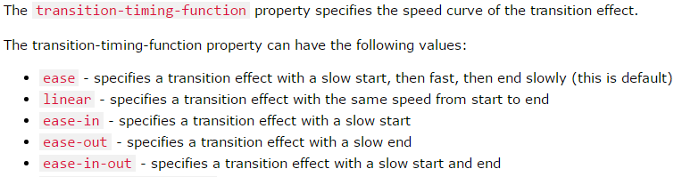
transition-timing-function

Slide 15
{
width:100px;
height:100px;
background : red;
/* For Safari 3.1 to 6.0 */
-webkit-transition-property : width;
-webkit-transition-duration : 2s;
-webkit-transition-timing-function : linear;
-webkit-transition-delay : 1s;
/* Standard syntax */
transition-property : width;
transition-duration: 2s;
transition-timing-function : linear;
transition-delay:1s;
}

Slide 16
div { -webkit-transition: width 2s linear 1s; /* For Safari 3.1 to 6.0 */ transition: width 2s linear 1s; /* Shorthand syntax */
}
div:hover { width:300px; }

Slide 17
Transition + Transformation
div {
width: 100px;
height: 100px;
background: red;
-webkit-transition: width 2s, height 2s, -webkit-transform 2s; /* Safari */
transition: width 2s, height 2s, transform 2s;
}
div : hover {
width: 300px;
height: 300px;
-webkit-transform: rotate(180deg); /* Safari */
transform: rotate(180deg);
}

Slide 18
CSS3 Animations

Slide 19
CSS3 @keyframes Rule
The @keyframes rule is where the animation is created.
Specify a CSS style inside the @keyframes rule and the animation will gradually change from the current style to the new style.

Slide 20
animation-name
animation-duration
animation-delay
animation-iteration-count
animation-direction
animation-timing-function

Slide 21
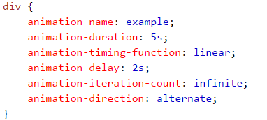

Animation Shorthand Property

Slide 22
CSS3 Animation
When an animation is created in the @keyframe rule, you must bind it to a selector, otherwise the animation will have no effect.
Bind the animation to a selector (element) by specifying at least these two properties:
the name of the animation
the duration of the animation

Slide 23
CSS3 Animation
div
{
width:100px;
height:100px;
background : red;
-webkit-animation : myfirst 5s; /* Chrome, Safari, Opera */
animation : myfirst 5s;
}
@-webkit-keyframes myfirst /* Chrome, Safari, Opera */
{
from {background : red;}
to {background : yellow;}
}

Slide 24
What Are CSS3 Animations?
An animation lets an element gradually change from one style to another.
You can change as many properties you want, as many times you want.
You can specify when the change will happen in percent, or you can use the keywords "from" and "to" (which represents 0% and 100%).
0% represents the start of the animation, 100% is when the animation is complete.

Slide 25
Change the background color when the animation is 25%, and 50%, and again when the animation is 100% complete:
@-webkit-keyframes myfirst { 0% {background: red;} 25% {background: yellow;} 50% {background: blue;} 100% {background: green;} }

Slide 26
Change the background color and the position when the animation is 25%, 50%, 75%, and again when the animation is 100% complete:
div
{
width:100px;
height:100px;
background:red;
position:relative;
-webkit-animation:myfirst 5s; /* Chrome, Safari, Opera */
animation:myfirst 5s;/*standared */
}
/* Chrome, Safari, Opera */
@-webkit-keyframes myfirst
{
0% {background:red; left:0px; top:0px;}
25% {background:yellow; left:200px; top:0px;}
50% {background:blue; left:200px; top:200px;}
75% {background:green; left:0px; top:200px;}
100% {background:red; left:0px; top:0px;}
}

